Slide 1
What are Computer Networks

Slide 2
What comprises a network?
Computer networks are comprised of 2 or more (usually more) “nodes”
Nodes are just another name for a device
Routers
Computers
Switches
IoT devices
Mobile phones
Servers
Your car
My plant pot (no, really)

Slide 3
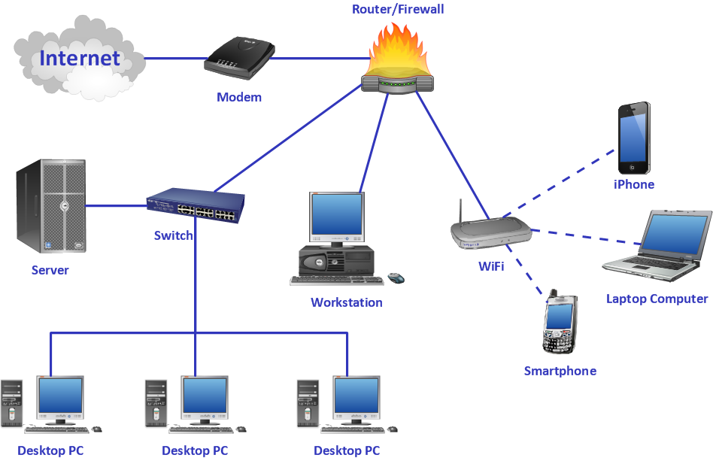

Slide 4

What are networks used for?
Used for sending data, IE 1’s and 0’s
Usually the data is sent in some structured format, known as a packet but not always.
What kind of data can we send?
Anything
Video
Audio
Images
Text
Numbers
It doesn’t matter, its all binary.

Slide 5
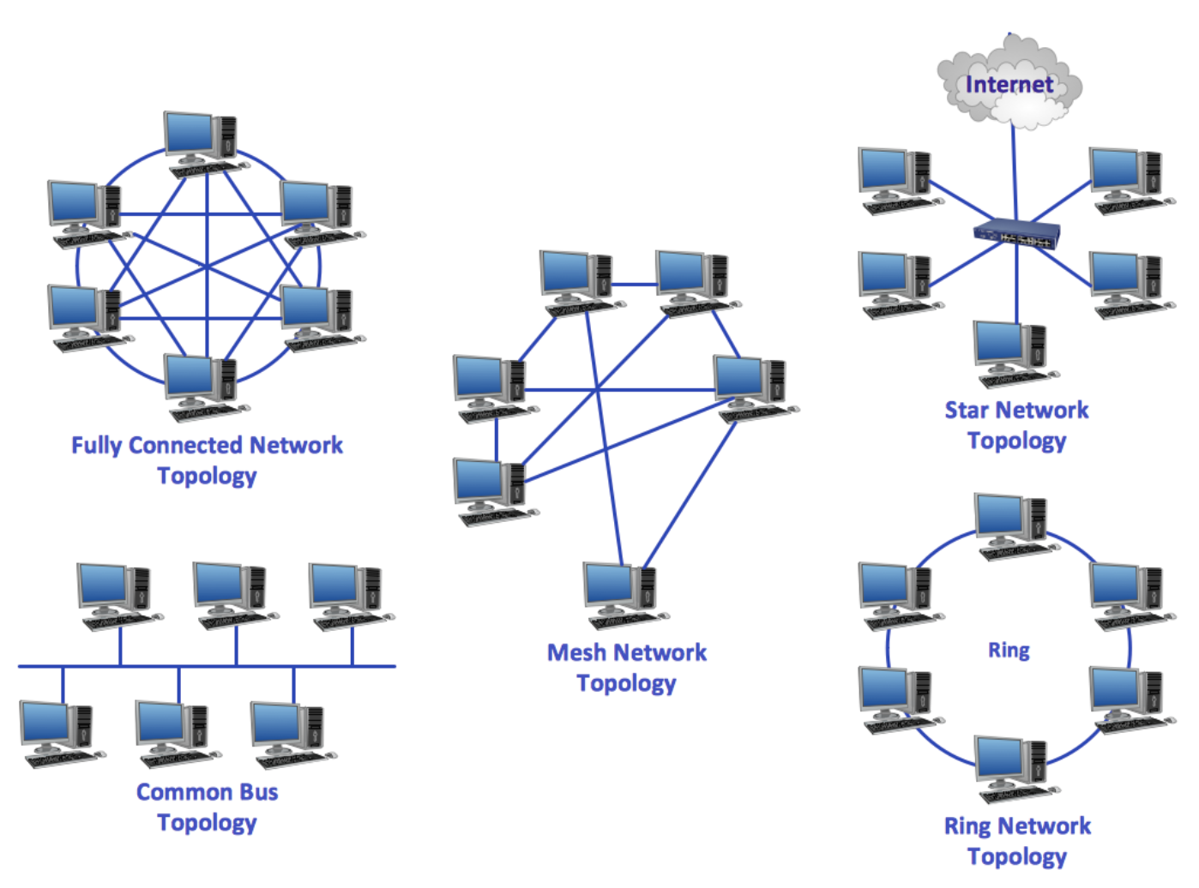
Topology

Slide 6
How do we know who’s who?
Depends on the network
In most cases we use numbers to represent a device
An IP address (internet protocol address)
And a MAC address (Media access control address)

Slide 7
What’s an IP address?
An IP address is a number that is used to distinguish your device form other devices on the network.
192.168.0.1
Only one computer can have a specific IP address
Ip addresses are usually assigned to a device by the DHCP server but they can also be set manually.
The DHCP server keeps a log of which device has which IP address
IP addresses can, and usually are, recycled as there are only so many IP addresses available. (IPv4 has a max of 2^32 = 4,294,967,296 )
So how do we know which device is which if we are assigning and reusing IP addressees?

Slide 8
MAC Addresses!
An IP address is not guaranteed to be in use by a specific device. So we cant use it to identify a device
For this, we use MAC addresses
On most big networks (those that use IP addresses), all devices have a MAC address
All mac addresses are unique (we have 2⁴⁸ =281,474,976,710,656 of them so every one can have there own!)
they look a bit like this: 00:0c:f6:83:12:0c

Slide 9
DHCP
To issue an IP address we need a DHCP server (Dynamic Host Control Protocol)
You probably have one set up and running on your home router.
New Device connects to network, requests an IP address
DHCP grabs the next available address and issues it to the new device, noting down the MAC of the new device.
Now, when data is sent to the new device, it will reach the router using IP address and the router will forward it to the mac address associate with that IP.

Slide 10
DNS
While we’re here, lets talk Domain Name Server’s for a minuet.
A domain name is something like www.google.com
IP addresses are not the easiest think to remember
So rather than trying to remember the IP address of google.com (its 8.8.8.8 by the way) we associate a domain name (which is easy to remember) with the IP of the server/servers that house the google web site.
When we type in www.google.com we contact a DNS server (the IP of which is already known by our gateway (that’s a fancy name for our router/ISP) ) and request a DNS look up for google.com
The DNS sever returns the IP address and then we attempt a connection to googles IP, 8.8.8.8.
If it works we use there site to search for what ever we want.
If it fails, check the sky and see if you see a hours man… or 4

Slide 11
By now you have probably figured out that networks are layers on top of layers.
This is exactly the case and leads on to the next lecture, transport layers and the OSI model.

Slide 12
Questions?

